Slide 1

Interacting with Multimodal Models and Agents with Ollama
By Charunthon Limseelo
Microsoft Learn Student Ambassador
This presentation is using for the event of
Journey to an AI Agent with LINE Chatbot and LLMs
at 12th Flr, Tisco Tower North Sathorn, Bangkok on May 4th

Slide 2
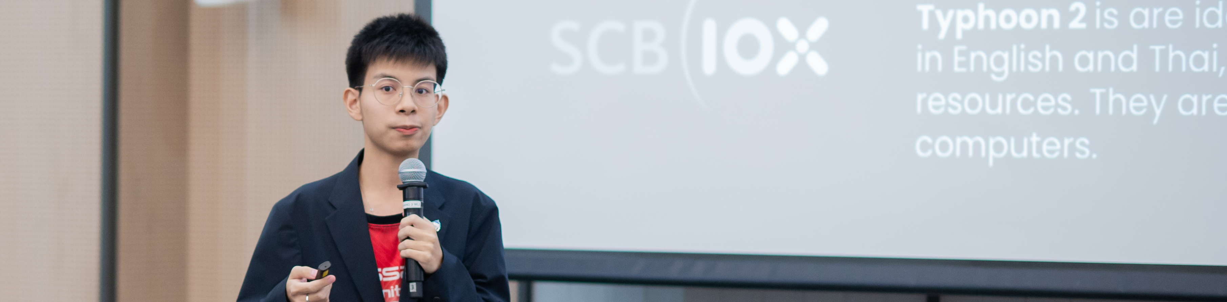
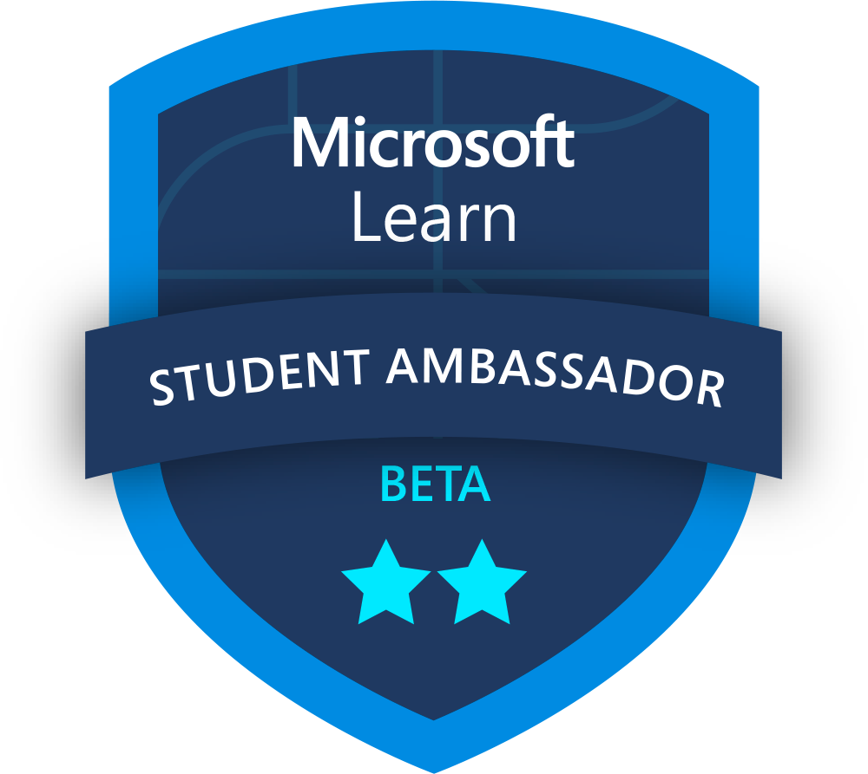
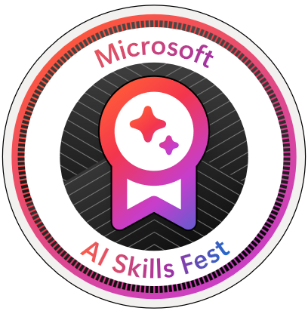



Session Speaker
boatchrnthn
Charunthon Limseelo (Boat)
Microsoft Learn Student Ambassador and Data Engineer Intern at Seven Peaks Software, Klong Toei, Bangkok, TH
Speaker on Various International Stages such as PyCon TH, FOSSASIA, JavaScript Bangkok, etc.
Charunthon Limseelo
Charunthon Limseelo

Slide 3
Interacting with multimodal Generative AI models and Agents
Text generation
Gemma 3 to generate text, or other models for reasoning tasks
Multimodal to text
Gemma 3, or other models to explore the different types of input
Pydantic Framework
Explore More Multimodal Models and usage of Ollama
Explore the capabilities of building agents to perform tasks

Slide 4
Section 1
Overall Picture of Multimodal Models And The Emergence of Small Models

Slide 5
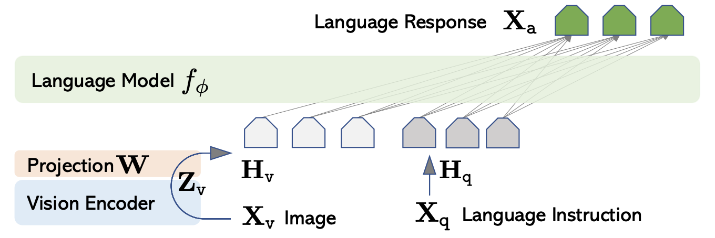
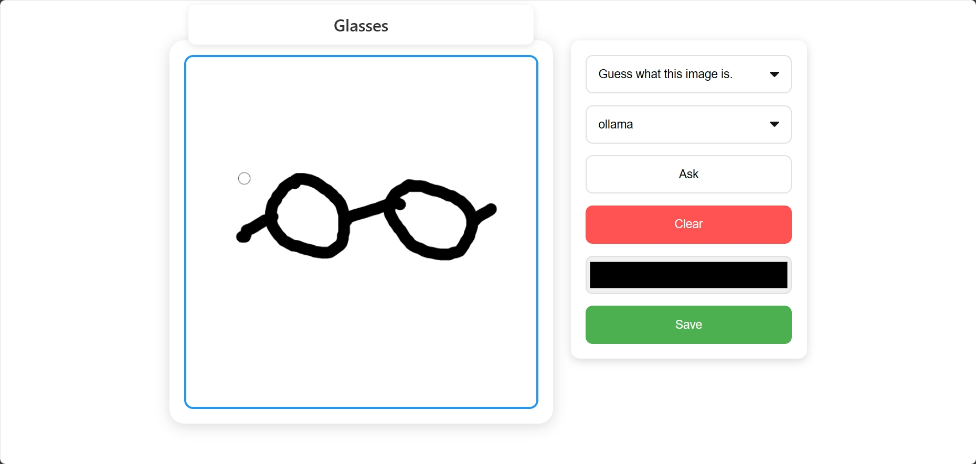
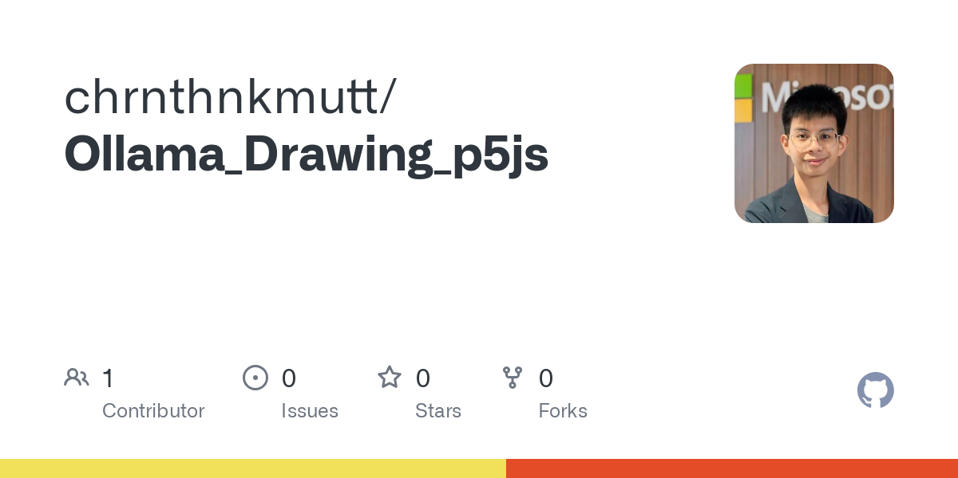
🔥
❄️
https://llava-vl.github.io/
https://github.com/chrnthnkmutt/Ollama_Drawing_p5js

Slide 6
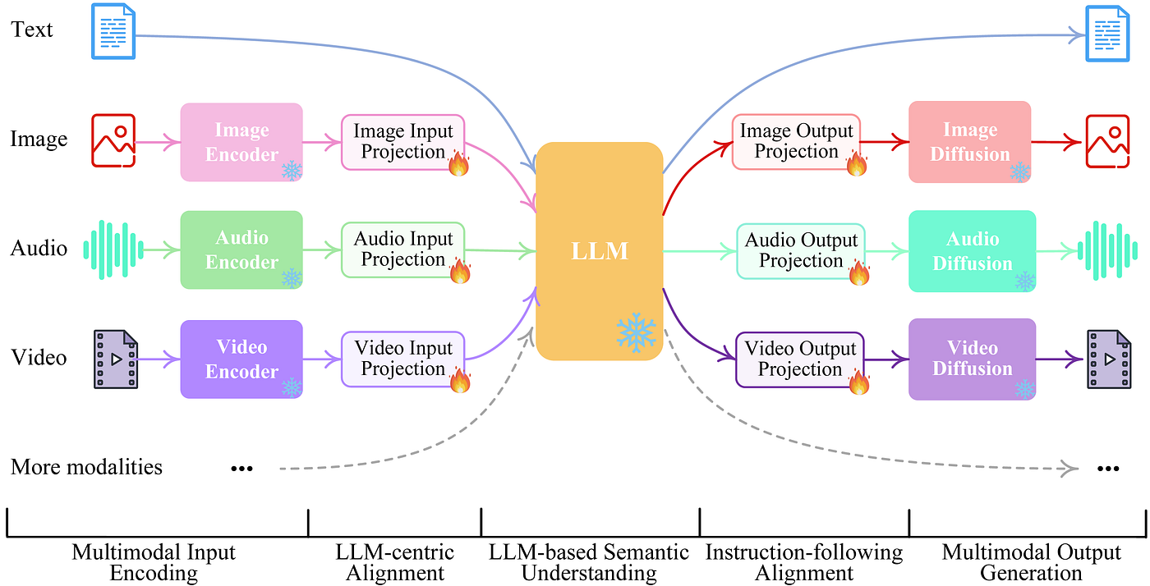

Slide 7




Small Language Models Benefits
Cost Effectiveness
Deployment Flexibility
Ultra-low
Latency
Easier to Customize

Slide 8





Small Language Models Benefits
Offline environments, on-device or on-prem, where local inference may be needed
Latency bound scenarios where fast response times are critical
Cost constrained tasks and use cases
Resource constrained environments
Select tasks can see improved performance via fine-tuning (vs. large model out-of-box)

Slide 9

Language Model Size Comparison
Large Size
More Generic
More Cost
Small Size
More Specific
Less Cost
Millions to few billions in parameters (should be lower than or equal to 8B)
Capable of being trained with consumer GPUs and lower budgets
Effective for specific and narrow tasks
More than ten billions in parameters
Requires substantial computational power for training and development
Higher performance in broader and more complex tasks

Slide 10
Section 2
Examples of Multimodal Models in Hugging Face and Usable in Ollama

Slide 11
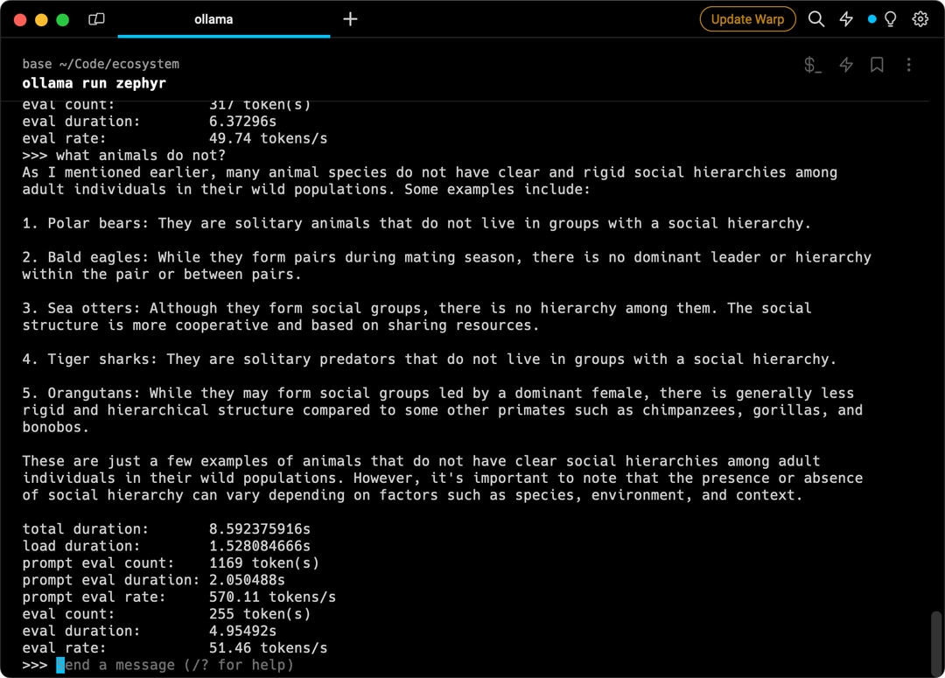



Ollama – Like Docker, But for LLMs
Created by Jeffrey Morgan
Ollama is a lightweight, extensible framework for building and running language models on the local machine. It provides a simple API for creating, running, and managing models, as well as a library of pre-built models that can be easily used in a variety of applications.

Slide 12
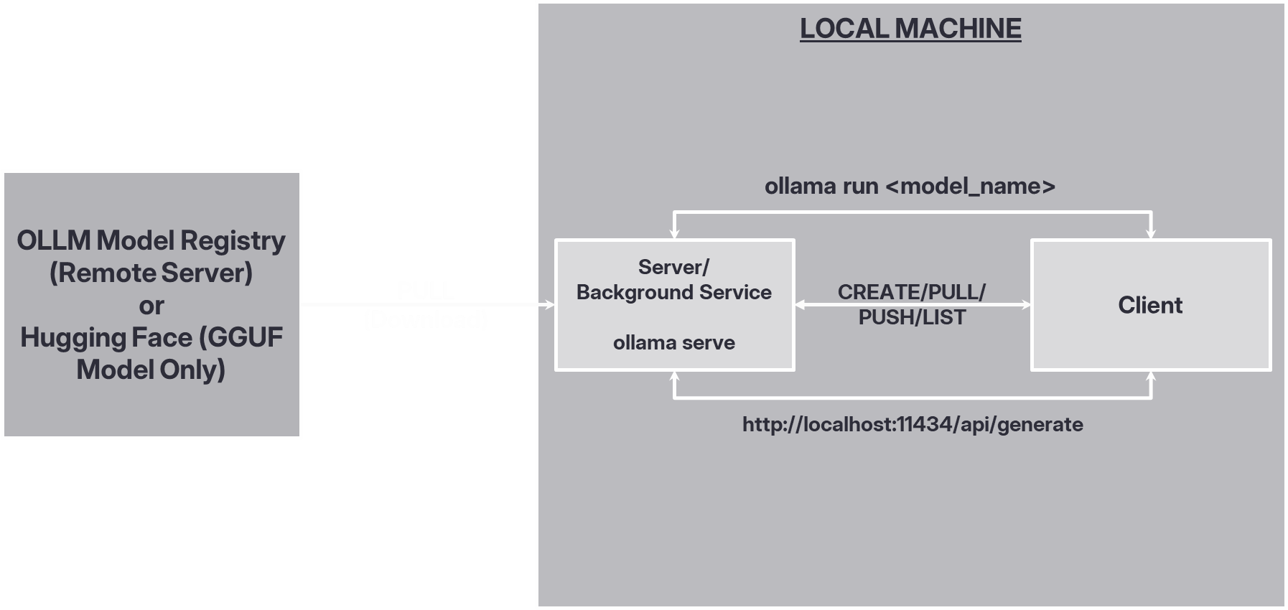
Inside’s Architecture

Slide 13

Gemma 3 4B
Gemma 3 models are multimodal, handling text and image input and generating text output, with open weights for both pre-trained variants and instruction-tuned variants.
Gemma 3 has a large, 128K context window, multilingual support in over 140 languages, and is available in more sizes than previous versions.
Gemma 3 models are well-suited for a variety of text generation and image understanding tasks, including question answering, summarization, and reasoning.
Their relatively small size makes it possible to deploy them in environments with limited resources such as laptops, desktops or your own cloud infrastructure, democratizing access to state-of-the-art AI models and helping foster innovation for everyone.
https://developers.googleblog.com/en/introducing-gemma3/

Slide 14
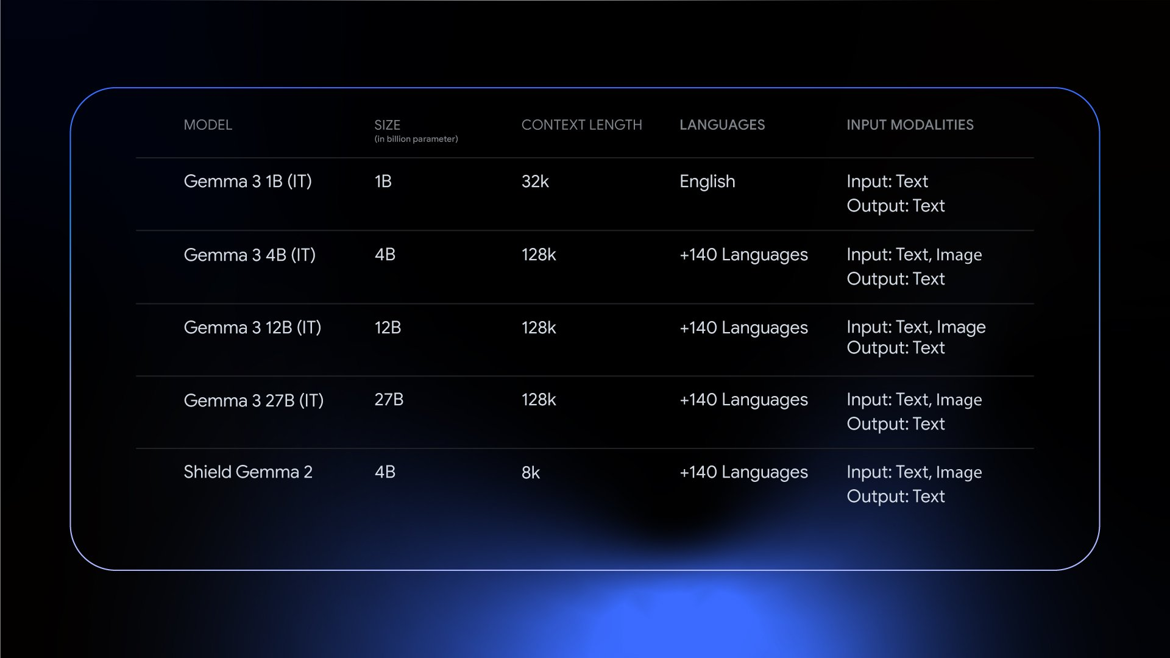
Performance

Slide 15
How it’s built?
Gemma's pre-training and post-training processes were optimized using a combination of distillation, reinforcement learning, and model merging. This approach results in enhanced performance in math, coding, and instruction following. Gemma 3 uses a new tokenizer for better multilingual support for over 140+ languages and was trained on 2T tokens for 1B, 4T for 4B, 12T for 12B, and 14T tokens for 27B, on Google TPUs using the JAX Framework.
For post-training, Gemma 3 uses 4 components:
Distillation from a larger instruct model into the Gemma 3 pre-trained checkpoints.
Reinforcement Learning from Human Feedback (RLHF) to align model predictions with human preferences.
Reinforcement Learning from Machine Feedback (RLMF) to enhance mathematical reasoning.
Reinforcement Learning from Execution Feedback (RLEF) to improve coding capabilities.
These updates significantly improved the model math, coding, and instruction following capabilities, making it the top open compact model in LMArena, with a score of 1338.

Slide 16
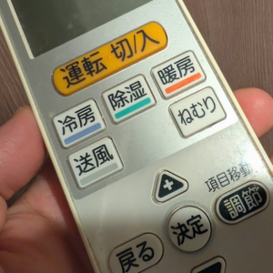

Multimodal Process
Based on the image, the button that likely turns up the heat is 暖房 (Danbou). "暖房" means "heating" in Japanese. It's the button you'd press to activate the heating function on the air conditioner/climate control system. The button with the plus sign (+) might adjust the temperature after you've selected the heating mode.
Input: I need to get warm. What button turns up the heat?

Slide 17
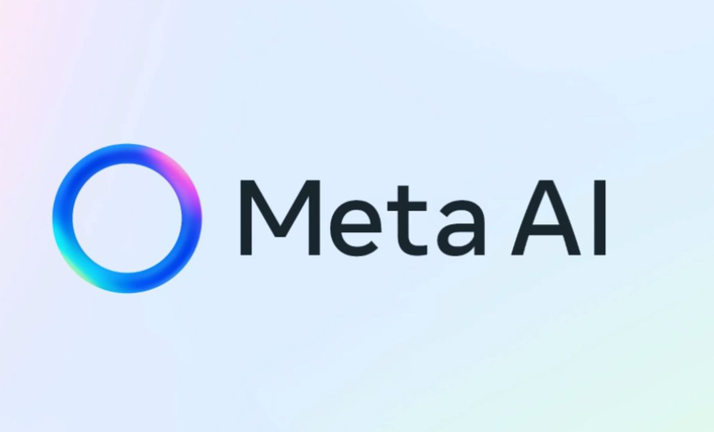
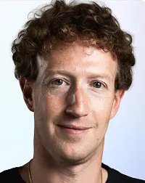
Model Card – Llama 4 Scout
Llama-4-Scout-17B-16E-Instruct
Architecture: approximately 17B active parameters from 109B, Mixture-of-Experts (MoE) model with early fusion for native multimodality.
Inputs: Multilingual text and images.
Context Window Length: 10M token context length
GPUs: Custom-built GPU clusters using H100-80GB
Training time: A cumulative total of 5.0M GPU hours
Training data: A mix of publicly available, licensed data, and information from Meta's products and services, including publicly shared posts on Instagram and Facebook and interactions with Meta AI.
Outputs: Multilingual text and code.
Dates: Trained until August 2024.
Status: Static model trained on an offline dataset, with potential future versions based on community feedback.
https://huggingface.co/meta-llama/Llama-4-Scout-17B-16E-Instruct
Llama 4 Scout 17B 16E Instruct · GitHub Models

Slide 18
Model Card – Llama 4 Maverick
Llama-4-maverick-17B-128E-Instruct
Architecture: approximately 17B active parameters from 400B, Mixture-of-Experts (MoE) model with early fusion for native multimodality.
Inputs: Multilingual text and images.
Context Window Length: 1M token context length
GPUs: Custom-built GPU clusters with H100-80GB GPUs
Training time: A cumulative total of 2.38M GPU hours
Training data: A mix of publicly available, licensed data, and information from Meta's products and services, including publicly shared posts on Instagram and Facebook and interactions with Meta AI.
Outputs: Multilingual text and code.
Dates: Trained until August 2024.
Status: Static model trained on an offline dataset, with potential future versions based on community feedback.
https://huggingface.co/meta-llama/Llama-4-Maverick-17B-128E-Instruct
Llama 4 Maverick 17B 128E Instruct FP8 · GitHub Models

Slide 19
Section 3
AI Agents Development and Open-Source Framework Examples: Pydantic

Slide 20
Agent
An agent in LLM-based applications is an autonomous software entity leveraging large language models to perform specific tasks through natural language interaction.
Independent
Goal-focused
Interactive

Slide 21
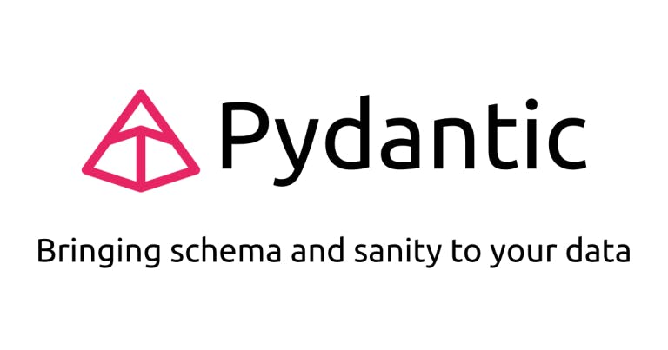
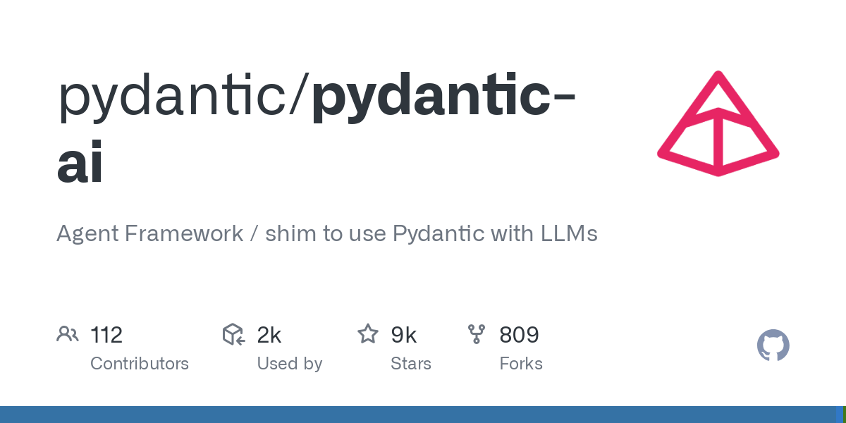
What is Pydantic and Pydantic AI?
Pydantic is the most widely used data validation library for Python.
PydanticAI is a Python agent framework designed to make it less painful to build production grade applications with Generative AI.
FastAPI revolutionized web development by offering an innovative and ergonomic design, built on the foundation of Pydantic.
Similarly, virtually every agent framework and LLM library in Python uses Pydantic, yet when we began to use LLMs in Pydantic Logfire, we couldn't find anything that gave us the same feeling.
https://huggingface.co/meta-llama/Llama-4-Scout-17B-16E-Instruct
Llama 4 Scout 17B 16E Instruct · GitHub Models

Slide 22
Example Syntax of Inferencing Models in Ollama with Pydantic AI
from pydantic import BaseModel
from pydantic_ai import Agent
from pydantic_ai.models.openai import OpenAIModel
from pydantic_ai.providers.openai import OpenAIProvider
class CityLocation(BaseModel):
city: str
country: str ollama_model = OpenAIModel(
model_name='llama3.2', provider=OpenAIProvider(base_url='http://localhost:11434/v1')
)
agent = Agent(ollama_model, output_type=CityLocation)
result = agent.run_sync('Where were the olympics held in 2012?')
print(result.output)
#> city='London' country='United Kingdom'
print(result.usage())
"""
Usage(requests=1, request_tokens=57, response_tokens=8, total_tokens=65, details=None)
"""

Slide 23
Demo Section
Running Multimodal Models with Normal Pydantic for Ollama Inference

Slide 24
Section 4
Key Takeaways + Study More

Slide 25
Key Takeaways
Multimodal Capabilities: Azure AI Foundry enables seamless interaction with AI models that process multiple types of data (text, images, audio, etc.), enhancing AI-powered applications.
GitHub Model Integration: Leveraging pre-trained AI models from GitHub simplifies deployment and experimentation, accelerating AI development within Azure.
Agent-Based AI Interactions: Intelligent agents in Azure AI Foundry provide dynamic responses and automate workflows, creating more intuitive user experiences.
Custom Model Adaptation: Developers can fine-tune and customize models to align with specific business needs, ensuring optimal AI performance.
Efficiency & Scalability: Azure AI Foundry offers robust infrastructure to scale AI solutions efficiently, supporting enterprise-grade implementations.

Slide 26
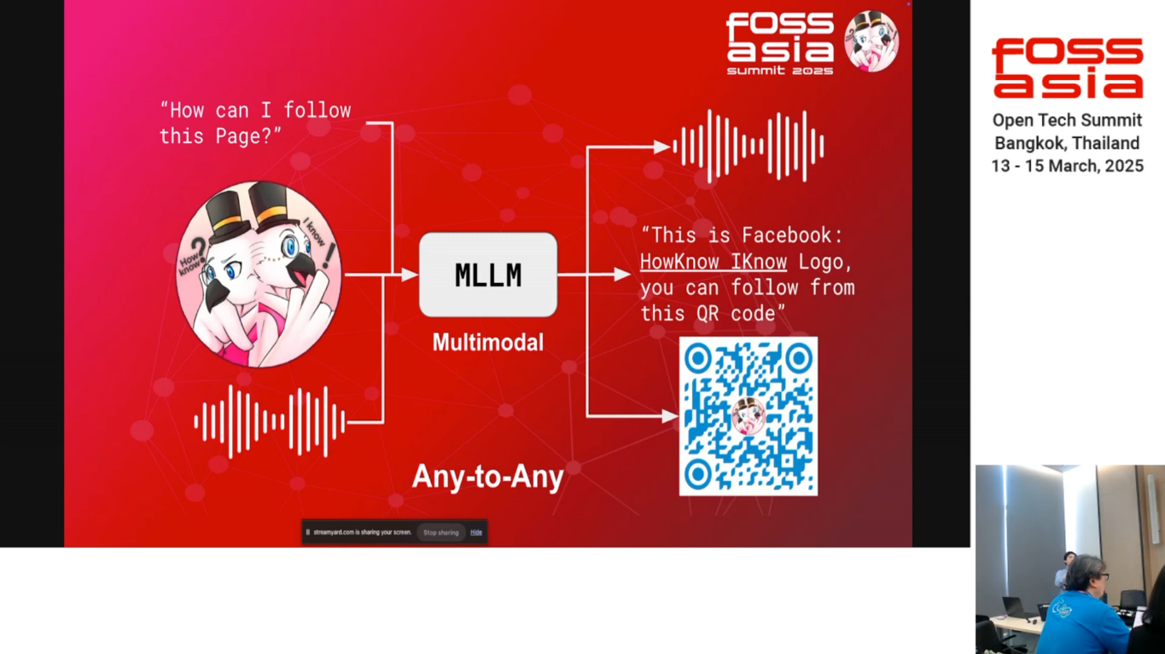
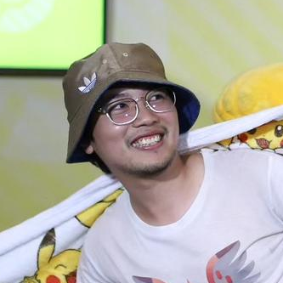
Study more about Multimodal models from here…..
Multimodal or Large Language Model, What model should I use?
Witthawin Sripheanpol HowKnow Iknow
Session from FOSSASIA
https://eventyay.com/e/4c0e0c27/session/9512

Slide 27
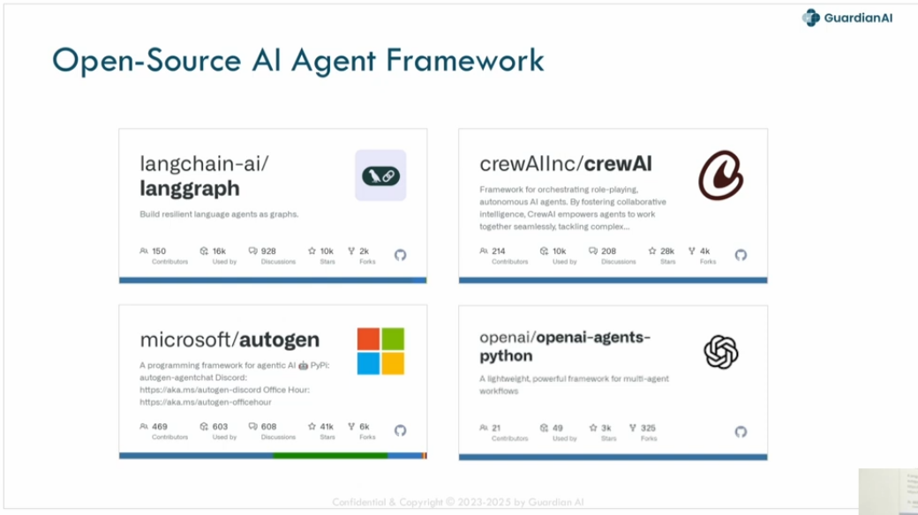

Study more about Open-Source Agent Frameworks
The Open-Source AI Agent
Sathapon Patanakuha
CEO, Guardian AI Lab
Session from FOSSASIA
https://eventyay.com/e/4c0e0c27/session/9513

Slide 28
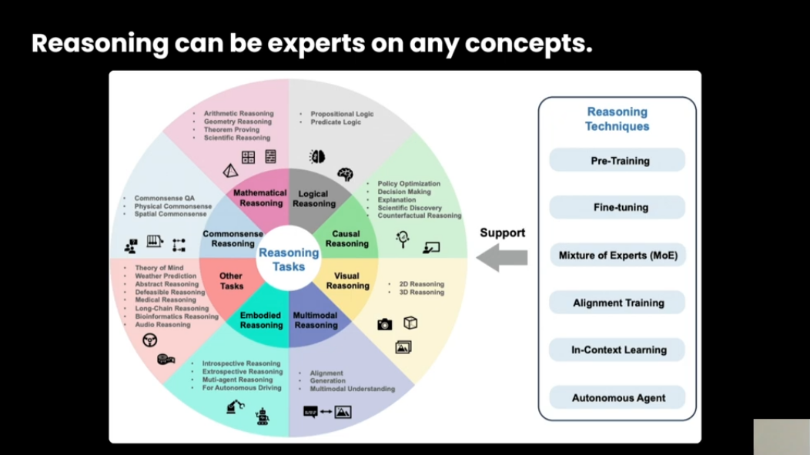

Study about Optimization and Use Cases from here…..
Small Language Models: The New Frontier of Developing Open-sourced Generative AI to Sustainability Goals
Charunthon Limseelo Microsoft Learn Student Ambassador
Session from FOSSASIA
https://eventyay.com/e/4c0e0c27/session/9389

Slide 29
Resource
GitHub Marketplace
github.com/marketplace/models
GitHub Models in .NET with Semantic Kernel Blog
gh.io/ModelsSemanticKernel
Build Generative AI apps with .NET and GitHub Models
gh.io/GitHubModelsandDotnet
Microsoft Reactor: Prototyping AI Agents with GitHub Models
https://www.youtube.com/watch?v=LflBM3ntUSY

Slide 30




Thank you 🙏
boatchrnthn
Charunthon Limseelo
Charunthon Limseelo
Scan QR to download the slide

